Slide 1
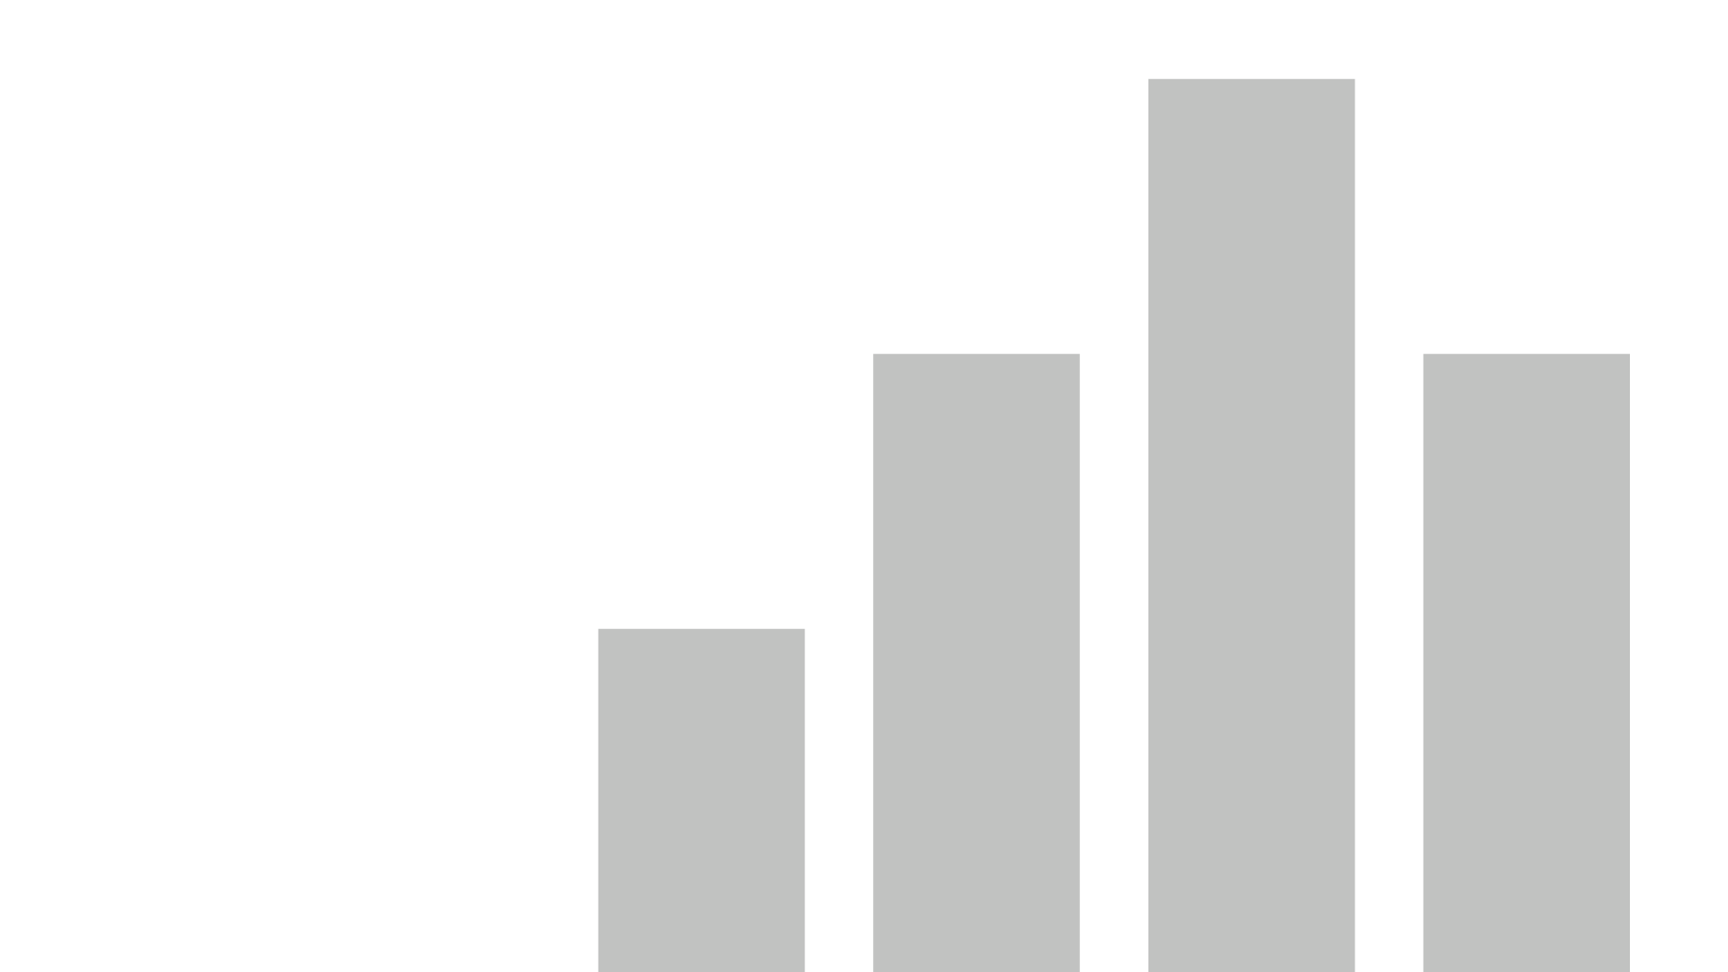


DASHBOARD ASSIGNMENT #3, Leon Gabriela
View in Power BI
Last data refresh:
10/15/2022 6:28:35 PM UTC
Downloaded at:
1/7/2023 6:51:40 PM UTC

Slide 2
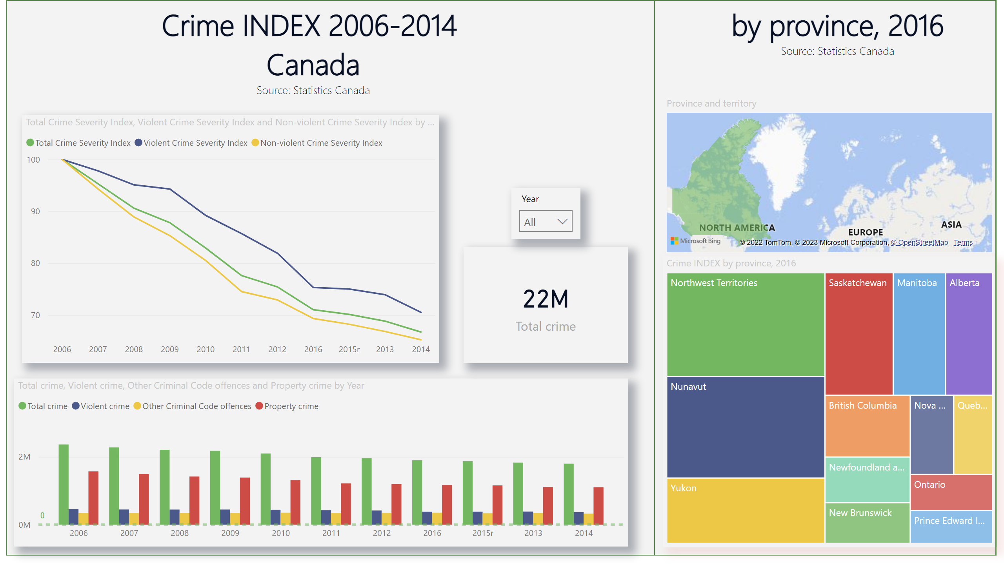
Crime
Notes:
slicer
No alt text provided
shape
No alt text provided
textbox
No alt text provided
shape
No alt text provided
textbox
No alt text provided
lineChart
No alt text provided
card
No alt text provided
clusteredColumnChart
No alt text provided
Crime INDEX by province, 2016
No alt text provided
filledMap
No alt text provided

Slide 3
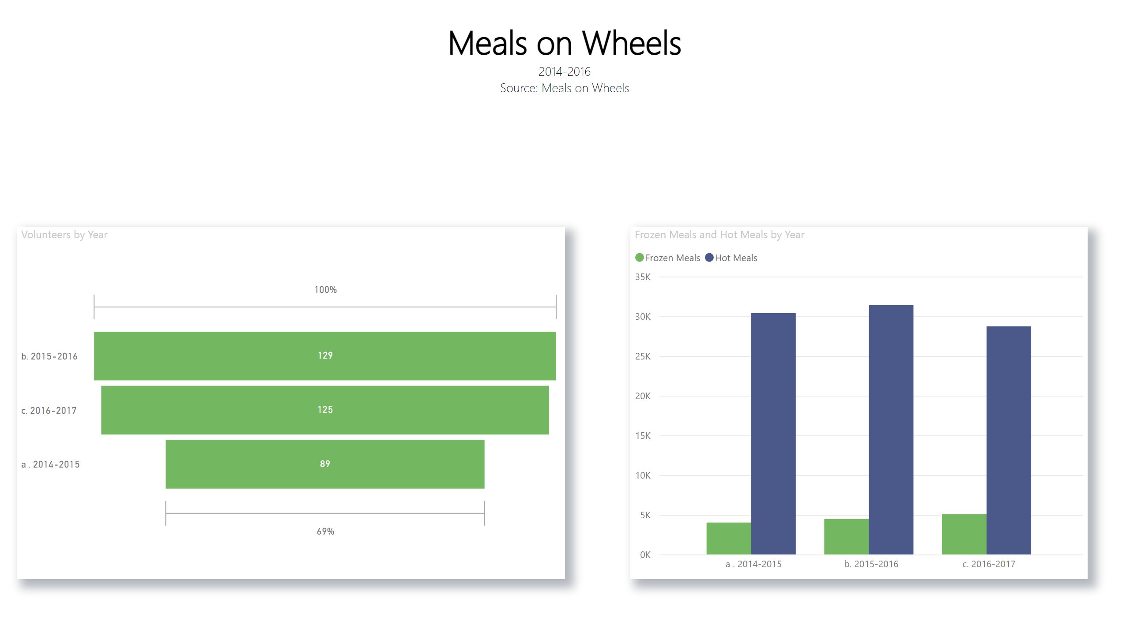
Volunteer
Notes:
textbox
No alt text provided
clusteredColumnChart
No alt text provided
funnel
No alt text provided

